Slide 1
Malignant tumors

Slide 2
Criteria of malignancy
Pleomorphism
Hyperchromatism
Increase nucleocytoplasmic ratio
Abnormal mitotic figures

Slide 3
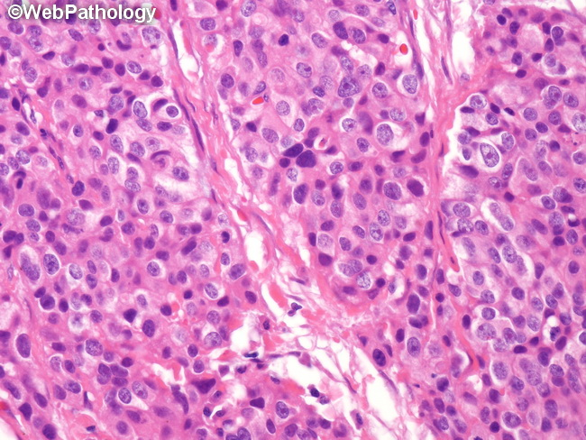
Criteria of malignancy

Slide 4
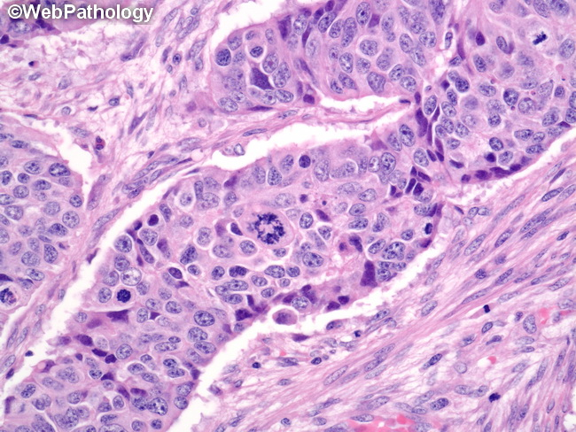

Slide 5
Squamous cell carcinoma

Slide 6
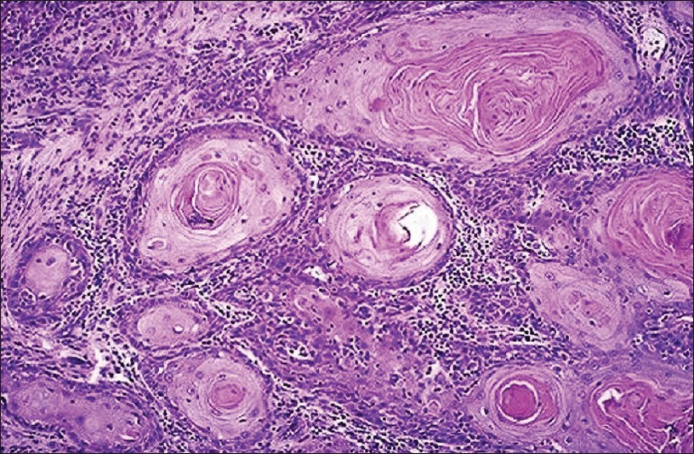
Squamous cell carcinoma

Slide 7
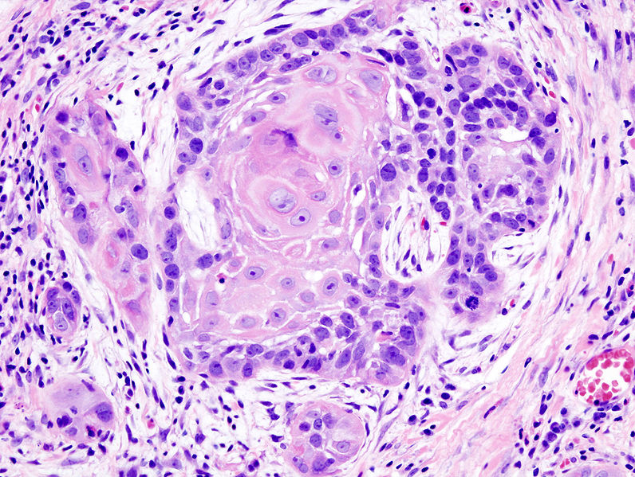

Slide 8
adenocarcinoma

Slide 9
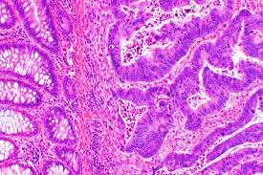
Adenocarcinoma

Slide 10
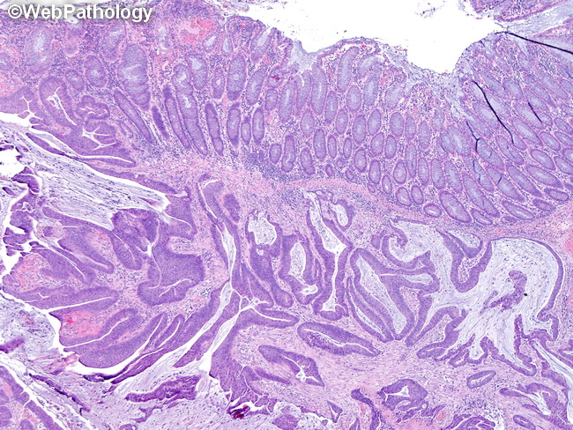

Slide 11
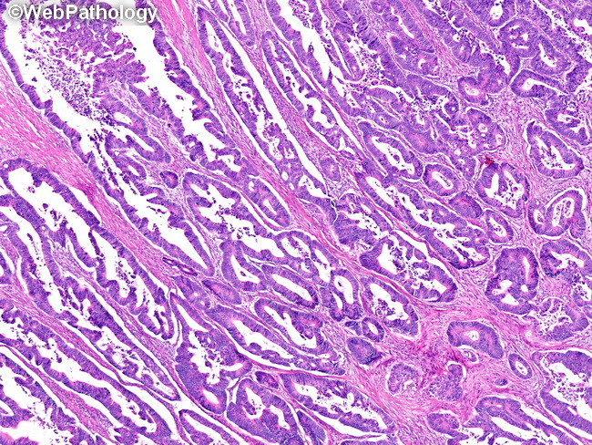

Slide 12
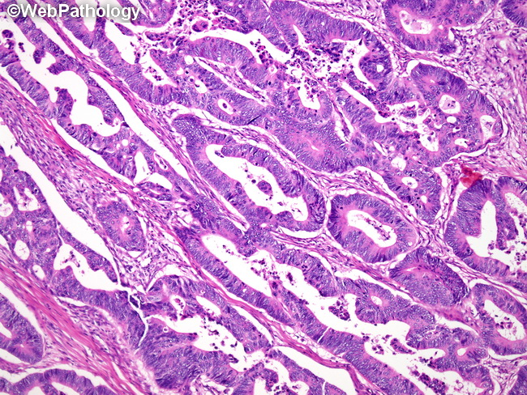

Slide 13
Chondrosarcoma

Slide 14
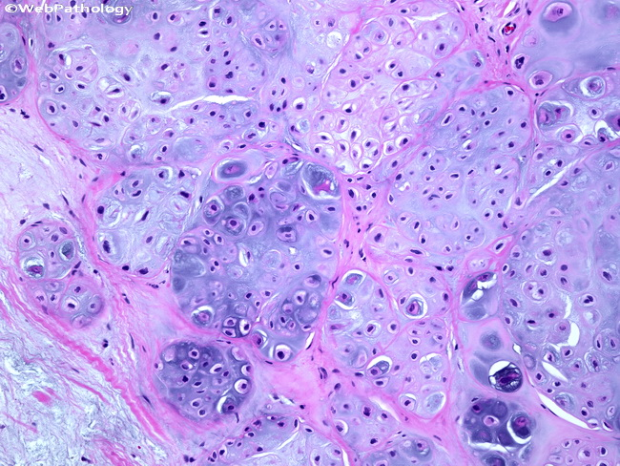
Well differentiated

Slide 15
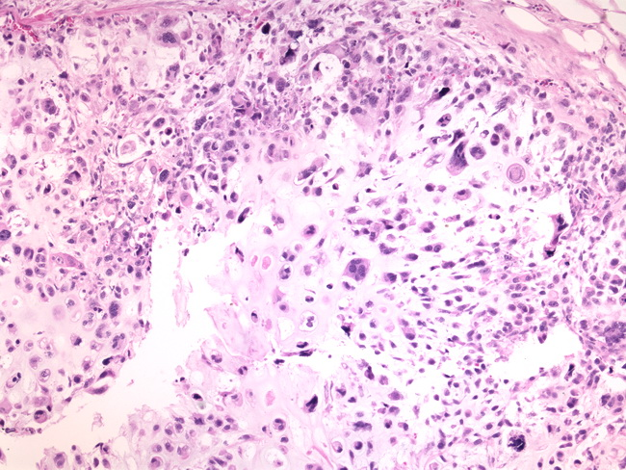
Poorly differentiated

Slide 16
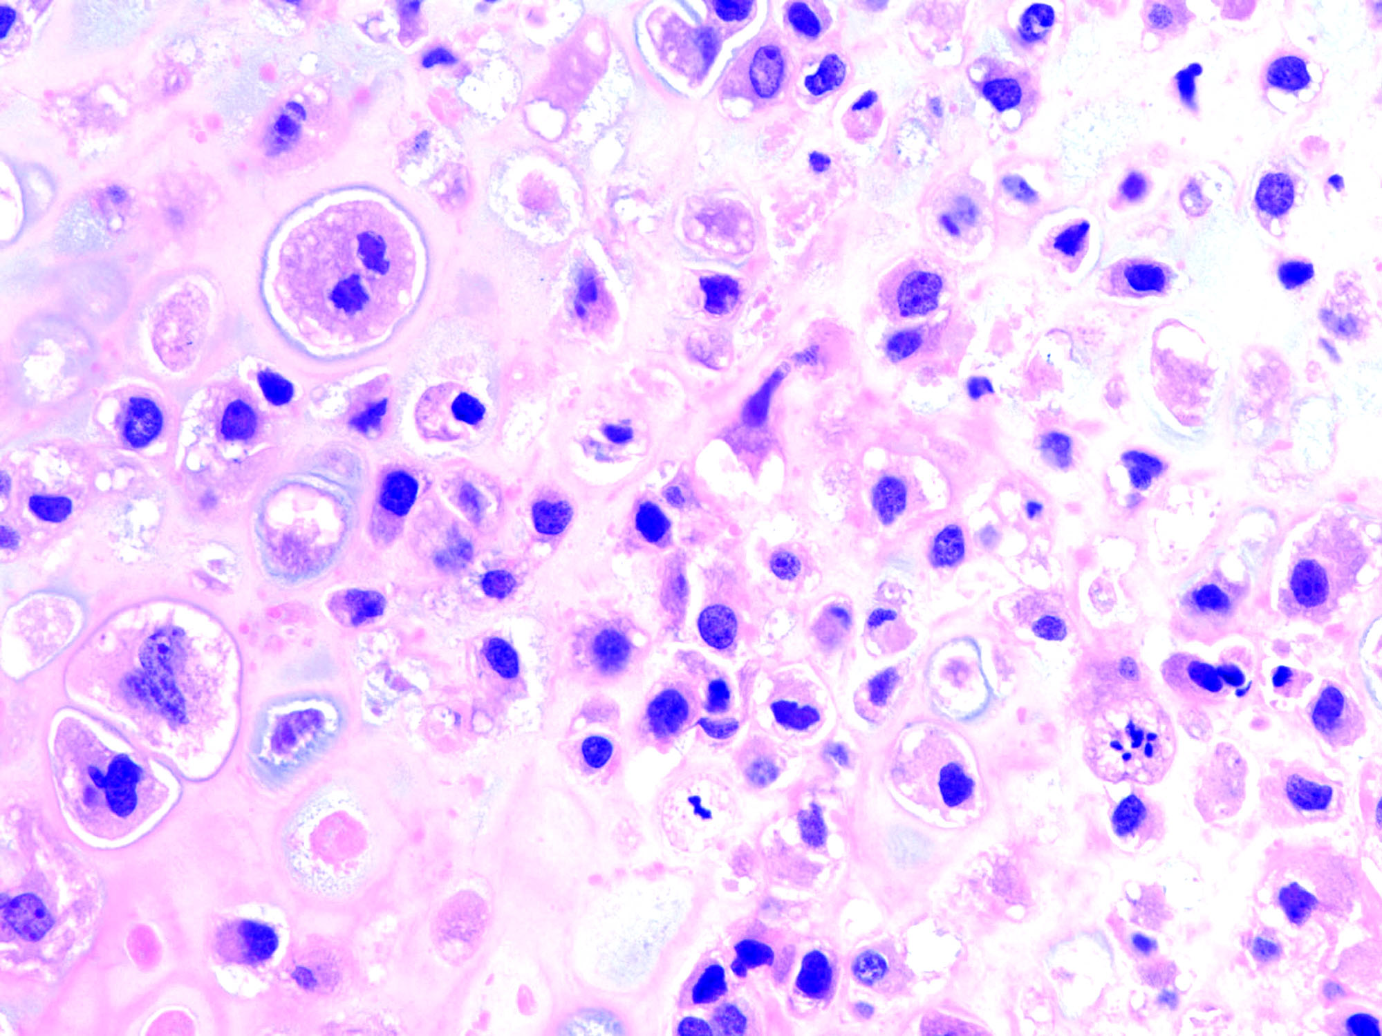
Note criteria of malignancy

Slide 17
